Slide 1
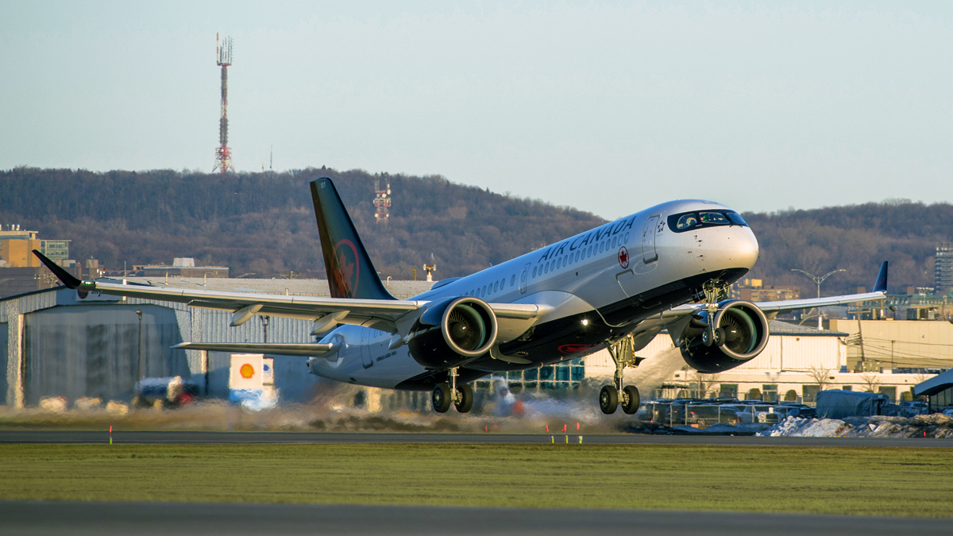
Airlines Case Study
Done BY
Urati Sampath Kumar

Slide 2
PART-A
Airline A is currently flying a large international network. Their flight operations are shown in the tab "Operations". Various aircraft characteristics are listed in tab "AC characteristics".
Total cost by every aircraft type for the year
 | Aircraft Type | Range (Km) | Number of Seats | Costs per flight hour | Total hours flown | Total Cost
1 | A330 | 8000 | 250 | 7500 | 21834 | 163755000
3 | B747 | 10000 | 350 | 12000 | 11037 | 132444000
0 | A320 | 5000 | 150 | 5000 | 14875 | 74375000
2 | B737 | 5000 | 150 | 5100 | 11816 | 60261600
4 | Q400 | 1500 | 90 | 3500 | 9476 | 33166000
5 | ATR72 | 1000 | 75 | 2750 | 9536 | 26224000

Slide 3
Above table is derived from making group by using aircraft type and summation of total hours in the whole year and joining this table with Aircraft Characteristics table and Multiplying total hours with cost per hour of aircraft to get Total Cost
Here A330 has flown more hours and it has the higest cost
B747 has more capacity in seating and Range it stands second in cost
ATR72 stands last in Cost but it has very special features like seating capacity is 75 and Range is 1000 Km we can use on those conditions satisfy it is most useful for short trips with less people

Slide 4
Aircraft type and Its cost per seat per km flown
Cost per seat Per Km = Total Cost / (no.of seats * total hours flown * Average Speed )
Here we can See that A330 has the lowest cost per seat per Km
it is the most econmical Aircraft Among all
 | Aircraft Type | Cost per seat per Km
1 | A330 | 0.033333
3 | B747 | 0.038095
0 | A320 | 0.041667
2 | B737 | 0.042500
4 | Q400 | 0.051852
5 | ATR72 | 0.056410

Slide 5
PART-B
To Finding the Best Aircrafts for Different city Pairs
First we check whether aircraft range is greater than the Distance between City
total cost of trip = cost per seat per Km * no.of Seats * no.of trips * Trip distance
no.of trips = pass demand per day/no.of seats
City Pairs Table
Origin City | Desitnation City | Pass. Demand (per day) | Distance (km)
AA | BB | 420 | 3,000
BB | CC | 450 | 6,500
CC | AA | 300 | 400
AA | DD | 300 | 1,000

Slide 6
Aircraft Operations Modified Table
 | Aircraft Type | Range (Km) | Number of Seats | Cost per seat per Km
0 | A320 | 5000 | 150 | 0.041667
1 | A330 | 8000 | 250 | 0.033333
2 | B737 | 5000 | 150 | 0.042500
3 | B747 | 10000 | 350 | 0.038095
4 | Q400 | 1500 | 90 | 0.051852
5 | ATR72 | 1000 | 75 | 0.056410

Slide 7
By Considering above Conditions and Tables we get Cost of every city pair for every aircraft in below table
 | Aircraft Type | Range (Km) | Number of Seats | Cost per seat per Km | AA-BB cost | BB-CC cost | CC-AA cost | AA-DD cost
0 | A320 | 5000 | 150 | 0.041667 | 56250 | NaN | 5000 | 12500
1 | A330 | 8000 | 250 | 0.033333 | 50000 | 108333 | 6666 | 16666
2 | B737 | 5000 | 150 | 0.042500 | 57375 | NaN | 5100 | 12750
3 | B747 | 10000 | 350 | 0.038095 | 80000 | 173333 | 5333 | 13333
4 | Q400 | 1500 | 90 | 0.051852 | NaN | NaN | 7466 | 18666
5 | ATR72 | 1000 | 75 | 0.056410 | NaN | NaN | 6769 | 16923

Slide 8
Most Suitable Economical Aircraft type for every City pair with number of trips
City Pair | Aircraft Type | No.of Trips | Cost
AA-BB | A330 | 2 | Rs.50000
BB-CC | A330 | 2 | Rs.108333
CC-AA | A320 | 2 | Rs.5000
AA-DD | A320 | 2 | Rs.12500

Slide 9
From AA-BB distance = 3000 , person demand per day = 420
- for aircraft A320 Range=5000 , No.of seats = 150
- It takes 3 trips i.e 420/150 =~ 3
- for air craft A330 Range=8000 , no.of seats = 250
- It takes 2 trips i.e 420/250 =~ 2
- for aircraft B737 Range=5000 , No.of seats = 150
- It takes 3 trips i.e 420/150 =~ 3
- for air craft B747 Range=10000 , no.of seats = 350
- It takes 2 trips i.e 420/350 =~ 2
- Other aircrafts range not sufficient for the distance
Among the Capable air Crafts **A330** is more Economical we can see in above table i.e **Rs.50000*

Slide 10
From BB-CC distance = 6500 , person demand per day = 450
- for air craft A330 Range=8000 , no.of seats = 250
- It takes 2 trips i.e 450/250 =~ 2
- for air craft B747 Range=10000 , no.of seats = 350
- It takes 2 trips i.e 450/350 =~ 2
- Other aircrafts range not sufficient for the distance
Among the Capable air Crafts **A330** is more Economical we can see in above table i.e **Rs.108333**

Slide 11
From CC-AA distance = 400 , person demand per day = 300
- for aircraft A320 Range=5000 , No.of seats = 150
- It takes 2 trips i.e 300/150 =~ 2
- for air craft A330 Range=8000 , no.of seats = 250
- It takes 2 trips i.e 300/250 =~ 2
- for aircraft B737 Range=5000 , No.of seats = 150
- It takes 2 trips i.e 300/150 =~ 2
- for air craft B747 Range=10000 , no.of seats = 350
- It takes 1 trips i.e 300/350 =~ 1
- for aircraft Q400 Range=1500 , No.of seats = 90
- It takes 4 trips i.e 300/90 =~ 4
- for air craft ATR72 Range=1000 , no.of seats = 75
- It takes 4 trips i.e 300/75 =~ 4
Among the Capable air Crafts **A320** is more Economical we can see in above table i.e **Rs.5000**
# We Can also Consider Aircraft **B747** is second most Economical i.e **RS.5333** but can be done in A single trip time and Energy both can be saved

Slide 12
From AA-DD distance = 1000 , person demand per day = 300
- for aircraft A320 Range=5000 , No.of seats = 150
- It takes 2 trips i.e 300/150 =~ 2
- for air craft A330 Range=8000 , no.of seats = 250
- It takes 2 trips i.e 300/250 =~ 2
- for aircraft B737 Range=5000 , No.of seats = 150
- It takes 2 trips i.e 300/150 =~ 2
- for air craft B747 Range=10000 , no.of seats = 350
- It takes 1 trips i.e 300/350 =~ 1
- for aircraft Q400 Range=1500 , No.of seats = 90
- It takes 4 trips i.e 300/90 =~ 4
- for air craft ATR72 Range=1000 , no.of seats = 75
- It takes 4 trips i.e 300/75 =~ 4
# Among the Capable air Crafts **A320** is more Economical we can see in above table i.e **Rs.12500**
# We Can also Consider Aircraft **B747** is second most Economical i.e **RS.13333** but can be done in A single trip time and Energy both can be saved

